Slide 1
Parliament makes law
Stages of a Bill
— the making of state, territory and federal laws.

Slide 2

Who makes laws in parliament?
Law-making is a key role of parliament.
Members of parliament debate, refine and vote on a proposal for a new law.
A law starts its life as a Bill, which is presented to parliament. Let’s learn more about how a Bill becomes law in Australia.

Slide 3

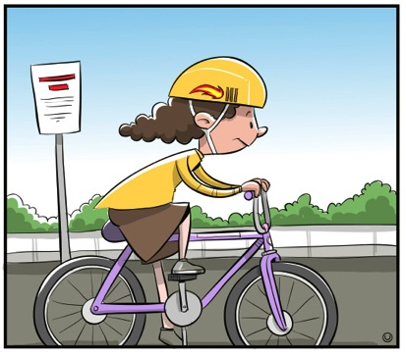

What is a Bill?
A proposal for a new law or a change to an old one is called a Bill.

Slide 4


Stages of the passage of a Bill
In federal parliament and in most state parliaments, the steps in the passage of a Bill involve:
Senate
(upper house)
State/Territory
Legislative Assembly
(lower house)
Legislative Council
(upper house)
Governor-General
(Royal assent)
Governor
(Royal assent)
House of Representatives
(lower house)
Federal
Federal
State/Territory

Slide 5
Stages of the passage of a Bill in federal parliament
HOUSE OF REPRESENTATIVES (LOWER HOUSE)
1st reading
The Bill is introduced to the House of Representatives.
2nd reading
Members debate and vote on the main ideas of the Bill.
House committee
Public investigation into the Bill and reporting back to the house.
Consideration in detail
Members discuss the Bill in detail, including any changes to the Bill. These changes are called ‘amendments’.
3rd reading
Members vote on the Bill in its final form.
Bill IS PASSED in the House of Representatives and sent to the Senate

Slide 6

Stages of the passage of a Bill in federal parliament
SENATE (UPPER HOUSE)
1st reading
The Bill is introduced to the Senate.
2nd reading
Senators debate and vote on the main ideas of the Bill.
Senate committee
Public inquiry into the Bill and reporting back to the house.
Consideration of the whole
Senators discuss the Bill in detail, including any changes to the Bill. These changes are called ‘amendments’.
3rd reading
Senators vote on the Bill in its final form.
Bill IS PASSED
If a change to the Bill has been made in the Senate, it must go back to the House of Representatives for agreement on the amendment.

Slide 7

Stages of the passage of a Bill in federal parliament
GOVERNOR-GENERAL (MONARCH’S REPRESENTATIVE IN AUSTRALIA)
Royal assent by the Governor-General
The Governor-General signs the Bill.
BILL BECOMES AN ACT OF PARLIAMENT
(A LAW OF AUSTRALIA)
Why do you think it is important that a Bill goes through so many stages before it can become a law?.

Slide 8
The stages of the passage of a Bill in the Queensland Parliament
1. Presentation, explanatory speech and first reading
2. Committee consideration
3. Committee report
4. Second reading
5. Consideration in detail
6. Third reading
7. Royal assent — signed by the Governor
THE BILL BECOMES LAW

Slide 9

Did you know?
Most Bills are introduced:
in the House of Representatives and then are sent to the Senate
by government ministers.
A Bill can be introduced into the Senate, except for Bills concerning:
money
taxation.
Bills can take weeks or months to pass through parliament.
200 Bills are introduced into parliament each year.
90 per cent of Bills are passed into law.
When a Bill is introduced by members of parliament who are not members of the government, it is called a private member’s Bill or a private senator’s Bill.

